Slide 1
The Data Link Layer(part 2)
Chapter 3
  Error Detection and Correction
Revised: August 2011
CN5E by Tanenbaum & Wetherall, © Pearson Education-Prentice Hall and D. Wetherall, 2011
Notes:
Gray units can be optionally omitted without causing later gaps

Slide 2
Error Control
Having solved the problem of marking the start and end of each frame,
we come to the next problem→ how to make sure all frames are eventually delivered to the network layer at the destination and in the proper order.
CN5E by Tanenbaum & Wetherall, © Pearson Education-Prentice Hall and D. Wetherall, 2011

Slide 3
Error Control
To ensure reliable delivery is to provide the sender with some feedback (special control frames bearing positive or negative acknowledgements)
    a positive acknowledgement → the frame has arrived safely.
    a negative acknowledgement → something has gone wrong, and the frame must be transmitted again.
a problem with the use of acknowledgement comes from the possibility that hardware troubles may cause a frame to vanish completely → the protocol (in which the sender transmit a frame and then waits for an acknowledgement, positive or negative) will hang forever if a frame is ever lost due to, for example, malfunctioning hardware.
Solution: use of Timer
CN5E by Tanenbaum & Wetherall, © Pearson Education-Prentice Hall and D. Wetherall, 2011
Notes:
We’ll get to this later in the chapter (error detection/correction, and elementary data link protocols)

Slide 4
Error Control (Cont.)
If either the frame or the acknowledgement is lost, the timer will go off, alerting the sender to the problem.
  retransmit the frame again.
  the receiver may accept the same frame two or more times and pass it to the network layer more than once.
  To prevent this from happening, it is generally necessary to assign sequence numbers to outgoing frames, so that the receiver can distinguish retransmissions from originals.
Notes
CN5E by Tanenbaum & Wetherall, © Pearson Education-Prentice Hall and D. Wetherall, 2011
Notes:
The whole issue of managing the timers and sequence numbers so as to ensure that each frame is ultimately
passed to the network layer at the destination exactly once, no more and no less, is an important part of the data
link layer's duties.

Slide 5
Flow Control
Another important design issue that occurs in the data link layer is what to do with a sender that systematically wants to transmit frames faster than the receiver can accept them.
CN5E by Tanenbaum & Wetherall, © Pearson Education-Prentice Hall and D. Wetherall, 2011
Notes:
This situation can easily occur when the sender is running on a fast (or lightly loaded) computer and the receiver is running on a
slow (or heavily loaded) machine.
The sender keeps pumping the frames out at a high rate until the receiver is completely flooded.
Even if the transmission is error free, at a certain point the receiver will simply be unable to handle the frames as they arrive and will start to lose some.
Clearly, something has to be done to prevent this situation.

Slide 6
Flow Control (Cont.)
Prevents a fast sender from out-pacing a slow receiver
  feedback-based flow control, the receiver sends back information to the sender giving it permission to send more data or at least telling the sender how the receiver is doing.
  rate-based flow control, the protocol has a built-in mechanism that limits the rate at which senders may transmit data, without using feedback from the receiver.
Flow control is a topic in the Link and Transport layers.
CN5E by Tanenbaum & Wetherall, © Pearson Education-Prentice Hall and D. Wetherall, 2011
Notes:
We’ll get to this later in the chapter (sliding window protocol) but note that flow control is mostly the responsibility of the Transport layer in practice (e.g., TCP)

Slide 7
Error Detection and Correction
Transmission errors are going to be with us for many years to come.
→We have to learn how to deal with them.
Notes
CN5E by Tanenbaum & Wetherall, © Pearson Education-Prentice Hall and D. Wetherall, 2011
Notes:
As a result of the physical processes that generate them, errors on some media (e.g., radio) tend to come in
bursts rather than singly.
Having the errors come in bursts has both advantages and disadvantages over isolated single-bit errors.
+++ On the advantage side, computer data are always sent in blocks of bits.
Suppose that the block size is 1000 bits and the error rate is 0.001 per bit.
If errors were independent, most blocks would contain an error.
If the errors came in bursts of 100 however, only one or two blocks in 100 would be affected, on average.
----- The disadvantage of burst errors is that they are much harder to correct than are isolated errors.

Slide 8
Error Detection and Correction
Two basic strategies to deal with errors:
  Include enough redundant information to enable the receiver to deduce what the transmitted data must have been.
  Error correcting codes.
  Include only enough redundancy to allow the receiver to deduce that an error has occurred (but not which error).
  Error detecting codes.

Slide 9
Error Detection and Correction
Error codes are examined in Link Layer because this is the first place that we have run up against the problem of reliability transmitting groups of bits.
  Codes are reused because reliability is an overall concern.
  The error correcting code are also seen in the physical layer for noise channels.
  Commonly they are used in link, network and transport layer.

Slide 10
Error Detection and Correction
Error codes have been developed after long fundamental research conducted in mathematics.
Many protocol standards get codes from the large field in mathematics.

Slide 11
Error Detection & Correction Code (1)
Hamming codes.
Binary convolutional codes.
Reed-Solomon codes.
Low-Density Parity Check codes.

Slide 12
Error Detection & Correction Code
All the codes presented in previous slide add redundancy to the information that is being sent.
A frame consists of
  m data bits (message) and
  r redundant bits (check).
Block code - the r check bits are computed solely as function of the m data bits with which they are associated.
Systemic code – the m data bits are send directly along with the check bits.

Slide 13
Error Correction – Hamming code
Hamming code is a set of error-correction codes that can be used to detect and correct the errors that can occur when the data is moved or stored from the sender to the receiver.
Redundant bits –extra binary bits that are generated and added to the information-carrying bits of data transfer to ensure that no bits were lost during the data transfer.
CN5E by Tanenbaum & Wetherall, © Pearson Education-Prentice Hall and D. Wetherall, 2011

Slide 14
Error Correction – Hamming code
The number of redundant bits can be calculated using the following formula:
2^r > m + r + 1
where, r = redundant bit, m = data bit
Suppose the number of data bits is 7, then the number of redundant bits can be calculated using:
= 2^4 > 7 + 4 + 1
Thus, the number of redundant bits= 4
CN5E by Tanenbaum & Wetherall, © Pearson Education-Prentice Hall and D. Wetherall, 2011

Slide 15
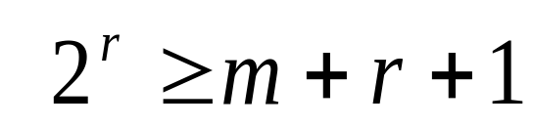
Data and redundancy bits
Number of data bits m | Number of redundancy bits r | Total bits m + r
1 | 2 | 3
2 | 3 | 5
3 | 3 | 6
4 | 3 | 7
5 | 4 | 9
6 | 4 | 10
7 | 4 | 11

Slide 16
Error Correction – Hamming code
Write the bit positions starting from 1 in binary form (1, 10, 11, 100, etc).
All the bit positions that are a power of 2 are marked as parity bits (1, 2, 4, 8, etc).
All the other bit positions are marked as data bits.
Each data bit is included in a unique set of parity bits, as determined its bit position in binary form.
    Parity bit 1 covers all the bits positions whose binary representation includes a 1 in the least significant position (1, 3, 5, 7, 9, 11, etc)
    Parity bit 2 covers all the bits positions whose binary representation includes a 1 in the second position from the least significant bit (2, 3, 6, 7, 10, 11, etc).
    Parity bit 4 covers all the bits positions whose binary representation includes a 1 in the third position from the least significant bit (4–7, 12–15, 20–23, etc).
    Parity bit 8 covers all the bits positions whose binary representation includes a 1 in the fourth position from the least significant bit bits (8–15, 24–31, 40–47, etc).
Since we check for even parity set a parity bit to 1 if the total number of ones in the positions it checks is odd.
Set a parity bit to 0 if the total number of ones in the positions it checks is even.

Slide 17
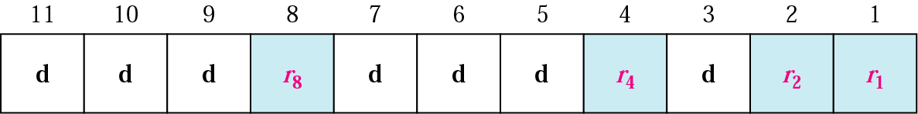
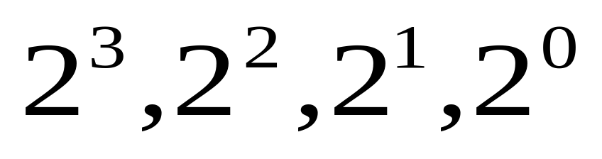
Positions of redundancy bits in Hamming code

Slide 18
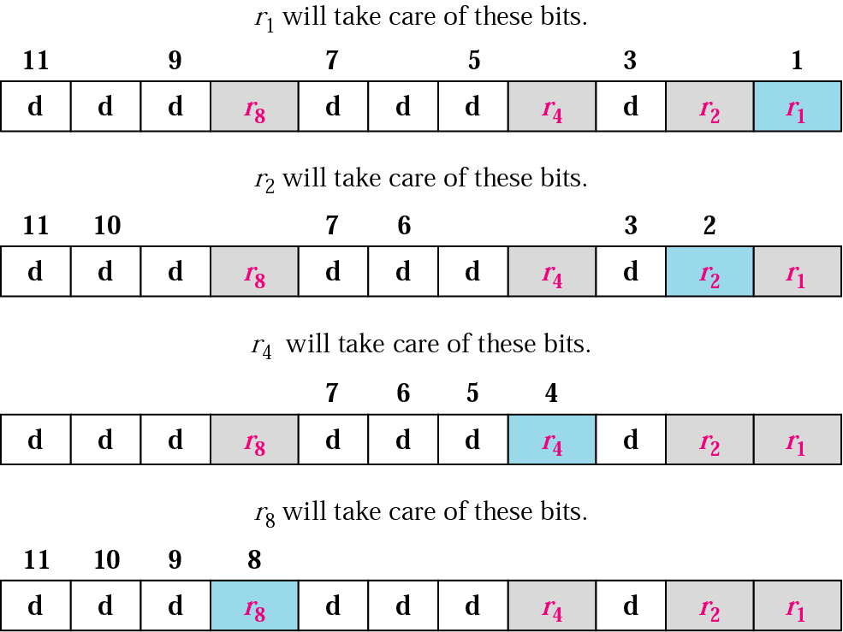
Redundancy bits calculation

Slide 19
Error Correction – Hamming code
Parity bits –a bit appended to a data of binary bits to ensure that the total number of 1’s in the data are even or odd. Parity bits are used for error detection.
    Even parity bit:
    In the case of even parity, for a given set of bits, the number of 1’s are counted. If that count is odd, the parity bit value is set to 1, making the total count of occurrences of 1’s an even number. If the total number of 1’s in a given set of bits is already even, the parity bit’s value is 0.
    Odd Parity bit –
    In the case of even parity, for a given set of bits, the number of 1’s are counted. If that count is even, the parity bit value is set to 1, making the total count of occurrences of 1’s an odd number. If the total number of 1’s in a given set of bits is already odd, the parity bit’s value is 0.
CN5E by Tanenbaum & Wetherall, © Pearson Education-Prentice Hall and D. Wetherall, 2011

Slide 20
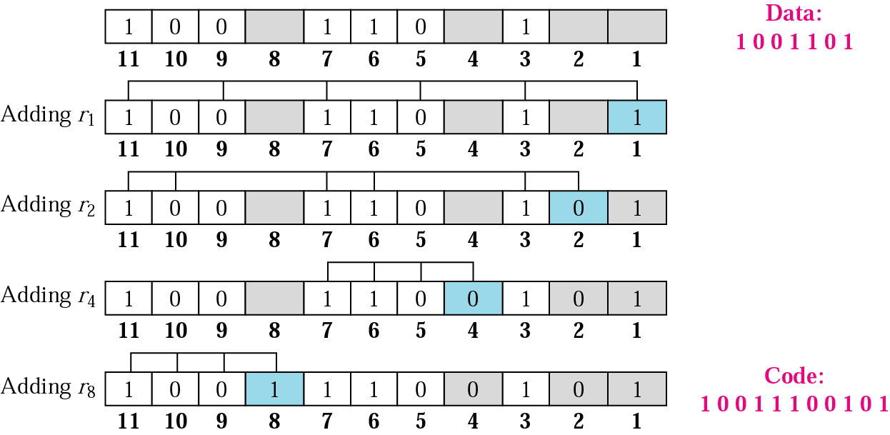
Example of redundancy bit calculation

Slide 21
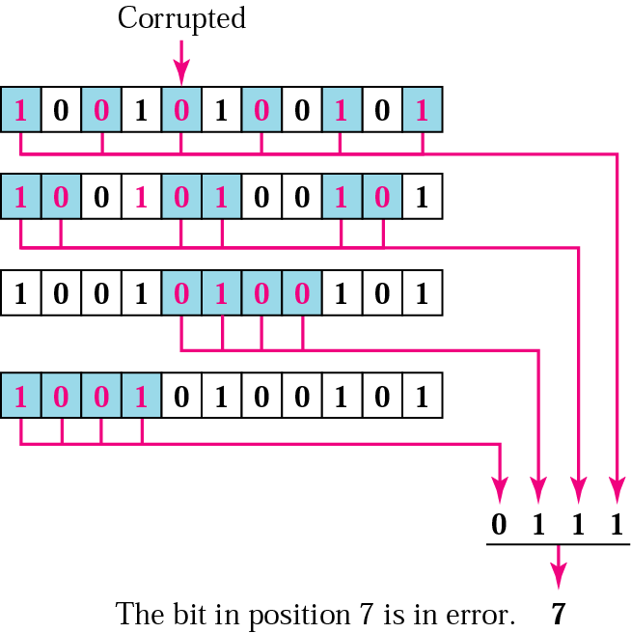
Error detection using Hamming code
1 0 0 1 1 1 0 0 1 0 1

Slide 22
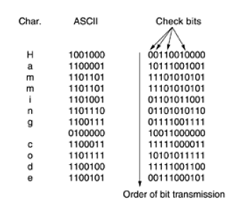
Error Correction – Hamming code
Hamming codes can only correct single errors, but there is a trick that can be used to permit Hamming codes to correct burst errors.
Notes:
A sequence of k consecutive codewords are arranged as a matrix, one codeword
per row. Normally, the data would be transmitted one codeword at a time, from left to right. To correct burst
errors, the data should be transmitted one column at a time, starting with the leftmost column. When all k bits
have been sent, the second column is sent, and so on, as indicated in Fig. 3-7. When the frame arrives at the
receiver, the matrix is reconstructed, one column at a time. If a burst error of length k occurs, at most 1 bit in
each of the k codewords will have been affected, but the Hamming code can correct one error per codeword, so
the entire block can be restored. This method uses kr check bits to make blocks of km data bits immune to a
single burst error of length k or less.

Slide 23
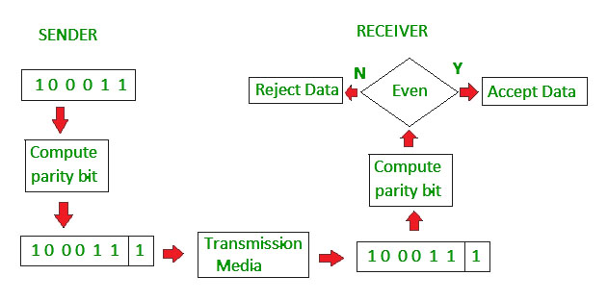
Error Detection – Parity
Blocks of data from the source are subjected to a check bit or parity bit generator form, where a parity of :
    1 is added to the block if it contains odd number of 1’s,
    0 is added if it contains even number of 1’s
This scheme makes the total number of 1’s even, that is why it is called even parity checking.
CN5E by Tanenbaum & Wetherall, © Pearson Education-Prentice Hall and D. Wetherall, 2011

Slide 24
Error Detection – Parity
Simple way to detect an odd number of errors
  Ex: 1 error, 11100101; detected, sum is wrong
  Ex: 3 errors, 11011001; detected sum is wrong
  Ex: 2 errors, 11101101; not detected, sum is right!
  Error can also be in the parity bit itself
  Random errors are detected with probability ½
CN5E by Tanenbaum & Wetherall, © Pearson Education-Prentice Hall and D. Wetherall, 2011

Slide 25
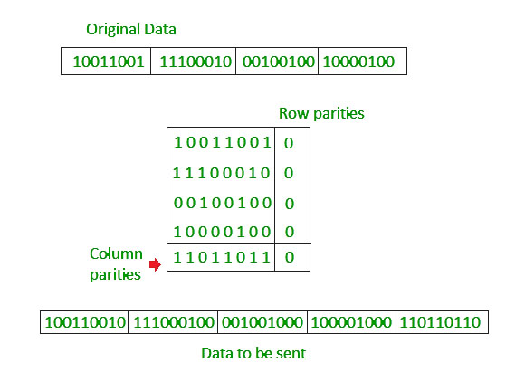
Error Detection – Parity
Two-dimensional Parity check
Parity check bits are calculated for each row, which is equivalent to a simple parity check bit. Parity check bits are also calculated for all columns, then both are sent along with the data. At the receiving end these are compared with the parity bits calculated on the received data.
CN5E by Tanenbaum & Wetherall, © Pearson Education-Prentice Hall and D. Wetherall, 2011

Slide 26
Error Detection – Checksums
An error-detection method in a the transmitter computes a numerical value according to the number of set or unset bits in a message and sends it along with each message frame.
At the receiver end, the same checksum function (formula) is applied to the message frame to retrieve the numerical value.
If the received checksum value matches the sent value, the transmission is considered to be successful and error-free.
CN5E by Tanenbaum & Wetherall, © Pearson Education-Prentice Hall and D. Wetherall, 2011

Slide 27
Checksum _ Example 1
On the board
CN5E by Tanenbaum & Wetherall, © Pearson Education-Prentice Hall and D. Wetherall, 2011

Slide 28
Checksum _ Example 2
the data is divided into k segments each of m bits.
In the sender’s end the segments are added using 1’s complement arithmetic to get the sum. The sum is complemented to get the checksum.
The checksum segment is sent along with the data segments.
At the receiver’s end, all received segments are added using 1’s complement arithmetic to get the sum. The sum is complemented.
If the result is zero, the received data is accepted; otherwise discarded.
CN5E by Tanenbaum & Wetherall, © Pearson Education-Prentice Hall and D. Wetherall, 2011

Slide 29
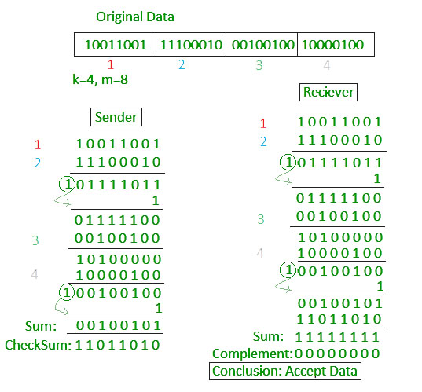
Checksum _ Example 2
CN5E by Tanenbaum & Wetherall, © Pearson Education-Prentice Hall and D. Wetherall, 2011

Slide 30
Error Detection – Checksums
Checksum treats data as N-bit words and adds N check bits that are the modulo 2^{N} sum of the words,
Properties:
  Improved error detection over parity bits
  Detects bursts up to N errors
  Detects random errors with probability 1-2^{N}
  Vulnerable to systematic errors, e.g., added zeros
CN5E by Tanenbaum & Wetherall, © Pearson Education-Prentice Hall and D. Wetherall, 2011

Slide 31
Error Detection – CRCs
Unlike checksum scheme, which is based on addition, CRC is based on binary division.
In CRC, a sequence of redundant bits, called cyclic redundancy check bits, are appended to the end of data unit so that the resulting data unit becomes exactly divisible by a second, predetermined binary number.
At the destination, the incoming data unit is divided by the same number. If at this step there is no remainder, the data unit is assumed to be correct and is therefore accepted.
A remainder indicates that the data unit has been damaged in transit and therefore must be rejected.
CN5E by Tanenbaum & Wetherall, © Pearson Education-Prentice Hall and D. Wetherall, 2011

Slide 32
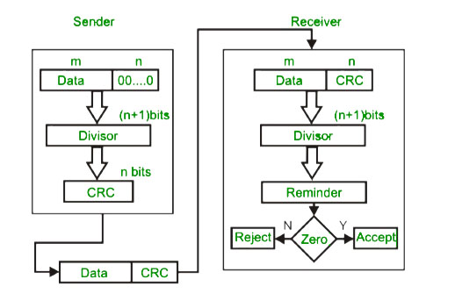
Error Detection – CRCs
CN5E by Tanenbaum & Wetherall, © Pearson Education-Prentice Hall and D. Wetherall, 2011

Slide 33
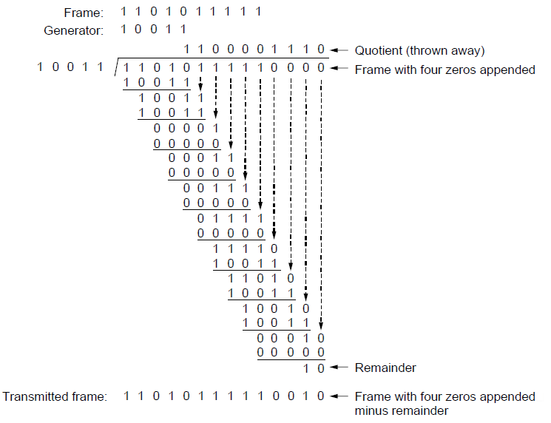
Error Detection – CRCs
Adds bits so that transmitted frame viewed as a polynomial is evenly divisible by a generator polynomial
Start by adding 0s to frame and try dividing
Offset by any reminder to make it evenly divisible
CN5E by Tanenbaum & Wetherall, © Pearson Education-Prentice Hall and D. Wetherall, 2011

Slide 34
Differnce between checksum and CRC
CRC is more thorough as opposed to Checksum in checking for errors and reporting.
Checksum is the older of the two programs.
CRC has a more complex computation as opposed to checksum.
Checksum mainly detects single-bit changes in data while CRC can check and detect double-digit errors.
CRC can detect more errors than checksum due to its more complex function.
A checksum is mainly employed in data validation when implementing software.
A CRC is mainly used for data evaluation in analogue data transmission
CN5E by Tanenbaum & Wetherall, © Pearson Education-Prentice Hall and D. Wetherall, 2011

Slide 35
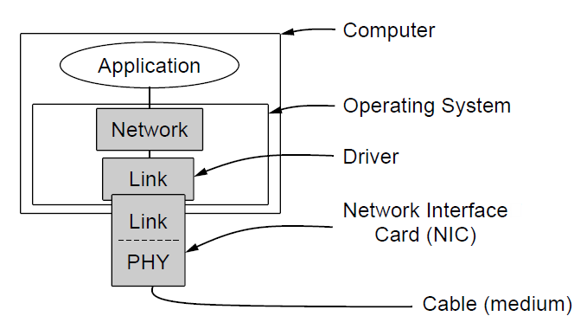
Link layer environment (1)
Commonly implemented as NICs and OS drivers; network layer (IP) is often OS software
CN5E by Tanenbaum & Wetherall, © Pearson Education-Prentice Hall and D. Wetherall, 2011
Notes:
Before we look at the protocols, it is useful to make explicit some of the assumptions underlying the model of
communication.
To start with, we assume that in the physical layer, data link layer, and network layer are
independent processes that communicate by passing messages back and forth. In many cases, the physical and
data link layer processes will be running on a processor inside a special network I/O chip and the network layer
code will be running on the main CPU. However, other implementations are also possible (e.g., three processes
inside a single I/O chip; or the physical and data link layers as procedures called by the network layer process).
In any event, treating the three layers as separate processes makes the discussion conceptually cleaner and
also serves to emphasize the independence of the layers.

Slide 36
Stop and Wait ARQ
(Automatic Repeat Request)
Used in Connection-oriented communication.
It offers error and flow control
It is used in Data Link and Transport Layers
Stop and Wait ARQ mainly implements Sliding Window Protocol concept with Window Size 1
CN5E by Tanenbaum & Wetherall, © Pearson Education-Prentice Hall and D. Wetherall, 2011

Slide 37
Useful Terms
Propagation Delay: Amount of time taken by a packet to make a physical journey from one router to another router.
    Propagation Delay = (Distance between routers) / (Velocity of propagation)
RoundTripTime (RTT) = 2* Propagation Delay
TimeOut (TO) = 2* RTT
Time To Live (TTL) = 2* TimeOut. (Maximum TTL is 180 seconds)
CN5E by Tanenbaum & Wetherall, © Pearson Education-Prentice Hall and D. Wetherall, 2011

Slide 38
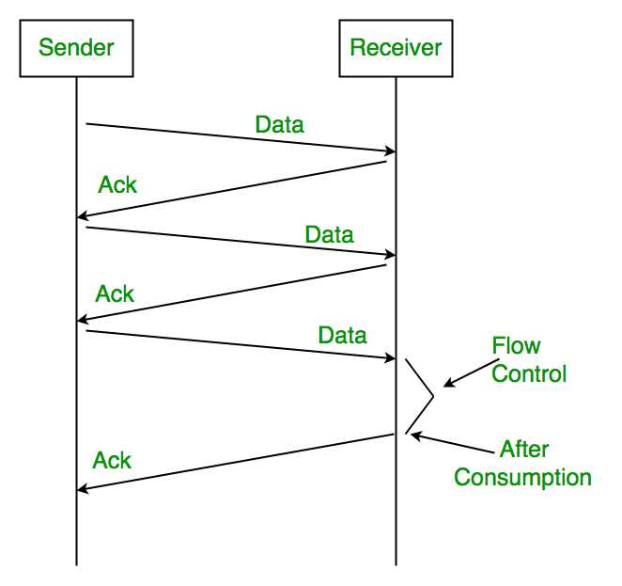
Simple Stop and Wait
Sender:
Rule 1) Send one data packet at a time.
Rule 2) Send next packet only after receiving acknowledgement for previous.
Receiver:
Rule 1) Send acknowledgement after receiving and consuming of data packet.
Rule 2) After consuming packet acknowledgement need to be sent (Flow Control)
CN5E by Tanenbaum & Wetherall, © Pearson Education-Prentice Hall and D. Wetherall, 2011

Slide 39
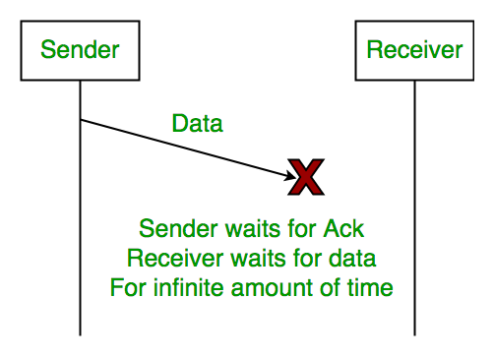
Problems (1)
1. Lost Data
CN5E by Tanenbaum & Wetherall, © Pearson Education-Prentice Hall and D. Wetherall, 2011

Slide 40
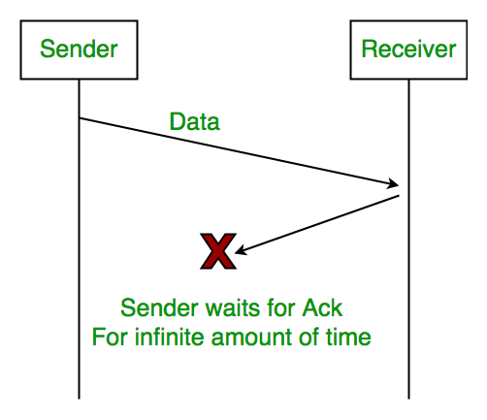
Problems (2)
Lost Acknowledgement
CN5E by Tanenbaum & Wetherall, © Pearson Education-Prentice Hall and D. Wetherall, 2011

Slide 41
Problems (3)
Delayed Acknowledgement/Data: After timeout on sender side, a long delayed acknowledgement might be wrongly considered as acknowledgement of some other recent packet.
CN5E by Tanenbaum & Wetherall, © Pearson Education-Prentice Hall and D. Wetherall, 2011

Slide 42
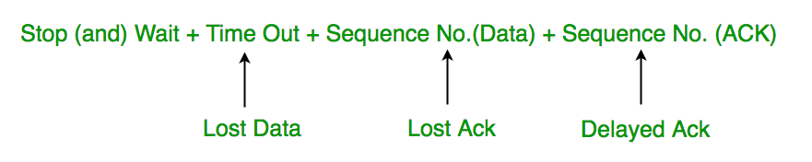
Stop and Wait ARQ (Automatic Repeat Request)
Above 3 problems are resolved by Stop and Wait ARQ (Automatic Repeat Request) that does both error control and flow control.
CN5E by Tanenbaum & Wetherall, © Pearson Education-Prentice Hall and D. Wetherall, 2011

Slide 43
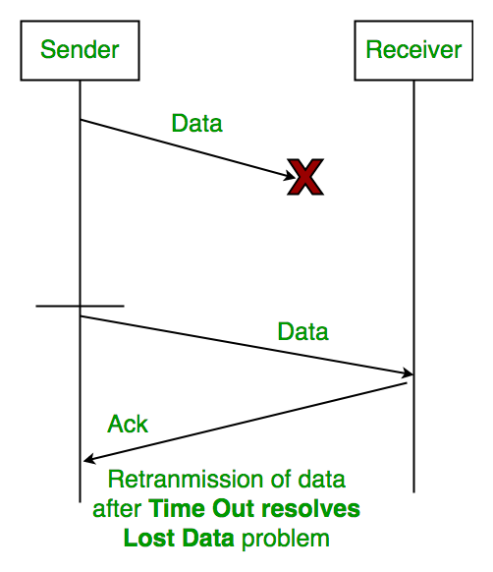
Time Out
CN5E by Tanenbaum & Wetherall, © Pearson Education-Prentice Hall and D. Wetherall, 2011

Slide 44
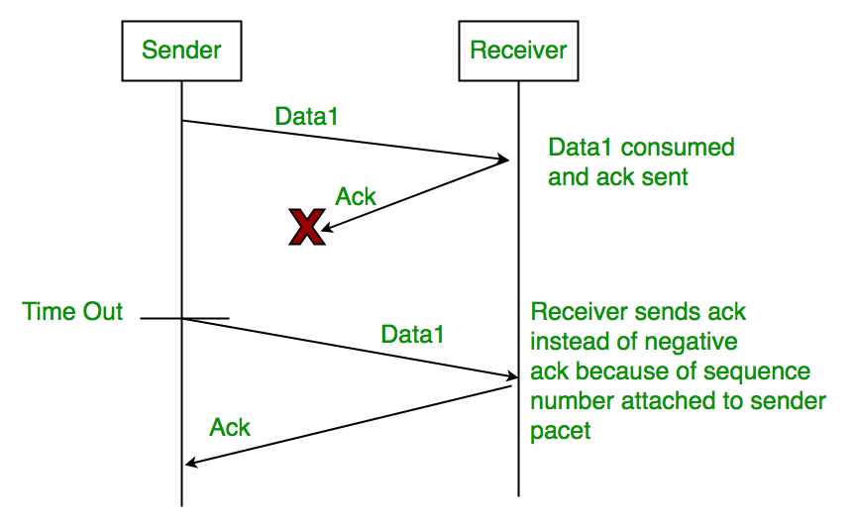
Sequence Number (Data)
CN5E by Tanenbaum & Wetherall, © Pearson Education-Prentice Hall and D. Wetherall, 2011

Slide 45
Delayed Acknowledgement
This is resolved by introducing sequence number for acknowledgement also.
CN5E by Tanenbaum & Wetherall, © Pearson Education-Prentice Hall and D. Wetherall, 2011

Slide 46
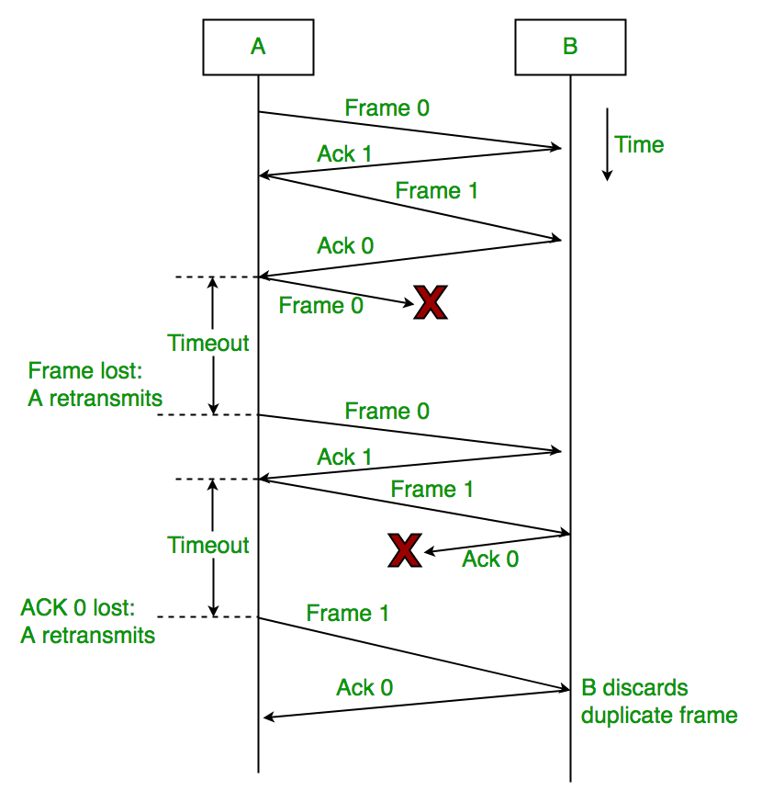
Working of Stop and Wait ARQ
Sender A sends a data frame or packet with sequence number 0.
2) Receiver B, after receiving data frame, sends and acknowledgement with sequence number 1 (sequence number of next expected data frame or packet).
There is only one bit sequence number that implies that both sender and receiver have buffer for one frame or packet only.
CN5E by Tanenbaum & Wetherall, © Pearson Education-Prentice Hall and D. Wetherall, 2011

Slide 47
Characteristics of Stop and Wait ARQ
It uses link between sender and receiver as half duplex link
Throughput = 1 Data packet/frame per RTT
If Bandwidth*Delay product is very high, then stop and wait protocol is not so useful. The sender has to keep waiting for acknowledgements before sending the processed next packet.
It is an example for “Closed Loop OR connection oriented “ protocols
It is an special category of SWP where its window size is 1
Irrespective of number of packets sender is having stop and wait protocol requires only 2 sequence numbers 0 and 1
CN5E by Tanenbaum & Wetherall, © Pearson Education-Prentice Hall and D. Wetherall, 2011

Slide 48
Characteristics of Stop and Wait ARQ
The Stop and Wait ARQ solves main three problems, but may cause big performance issues as sender always waits for acknowledgement even if it has next packet ready to send.
  Consider a situation where you have a high bandwidth connection and propagation delay is also high (you are connected to some server in some other country though a high speed connection). To solve this problem, we can send more than one packet at a time with a larger sequence numbers. We will be discussing these protocols in next articles.
So Stop and Wait ARQ may work fine where propagation delay is very less for example LAN connections, but performs badly for distant connections like satellite connection.
CN5E by Tanenbaum & Wetherall, © Pearson Education-Prentice Hall and D. Wetherall, 2011

Slide 49
Sliding Window Protocols
The Stop and Wait ARQ offers error and flow control, but may cause big performance issues as sender always waits for acknowledgement even if it has next packet ready to send. Consider a situation where you have a high bandwidth connection and propagation delay is also high (you are connected to some server in some other country though a high speed connection), you can’t use this full speed due to limitations of stop and wait.
Sliding Window protocol handles this efficiency issue by sending more than one packet at a time with a larger sequence numbers. The idea is same as pipelining in architectures.
CN5E by Tanenbaum & Wetherall, © Pearson Education-Prentice Hall and D. Wetherall, 2011

Slide 50
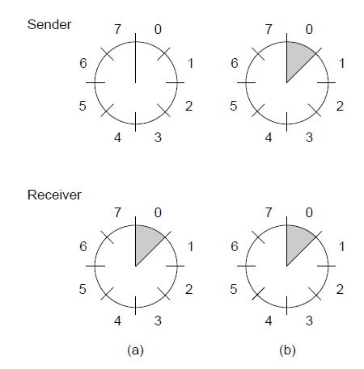
Sliding Window Protocols
A sliding window of size 1, with a 3-bit sequence number.
(a) Initially. (b) After the first frame has been sent.

Slide 51

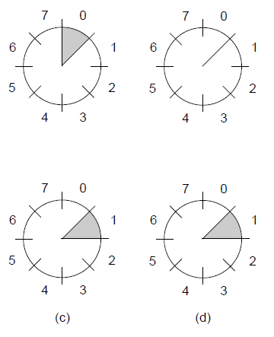

Sliding Window Protocols
A sliding window of size 1, with a 3-bit sequence number.
(c) After the first frame has been received. (d) After the first acknowledgement has been received.

Slide 52
Concept Of Pipelining
In Stop and Wait protocol, only 1 packet is transmitted onto the link and then sender waits for acknowledgement from the receiver. The problem in this setup is that efficiency is very less as we are not filling the channel with more packets after 1st packet has been put onto the link. Within the total cycle time of Tt + 2*Tp units, we will now calculate the maximum number of packets that sender can transmit on the link before getting an acknowledgement.
Transmission Delay (Tt)
Propagation Delay (Tp)

Slide 53
End
Chapter 3
CN5E by Tanenbaum & Wetherall, © Pearson Education-Prentice Hall and D. Wetherall, 2011

